Slide 1



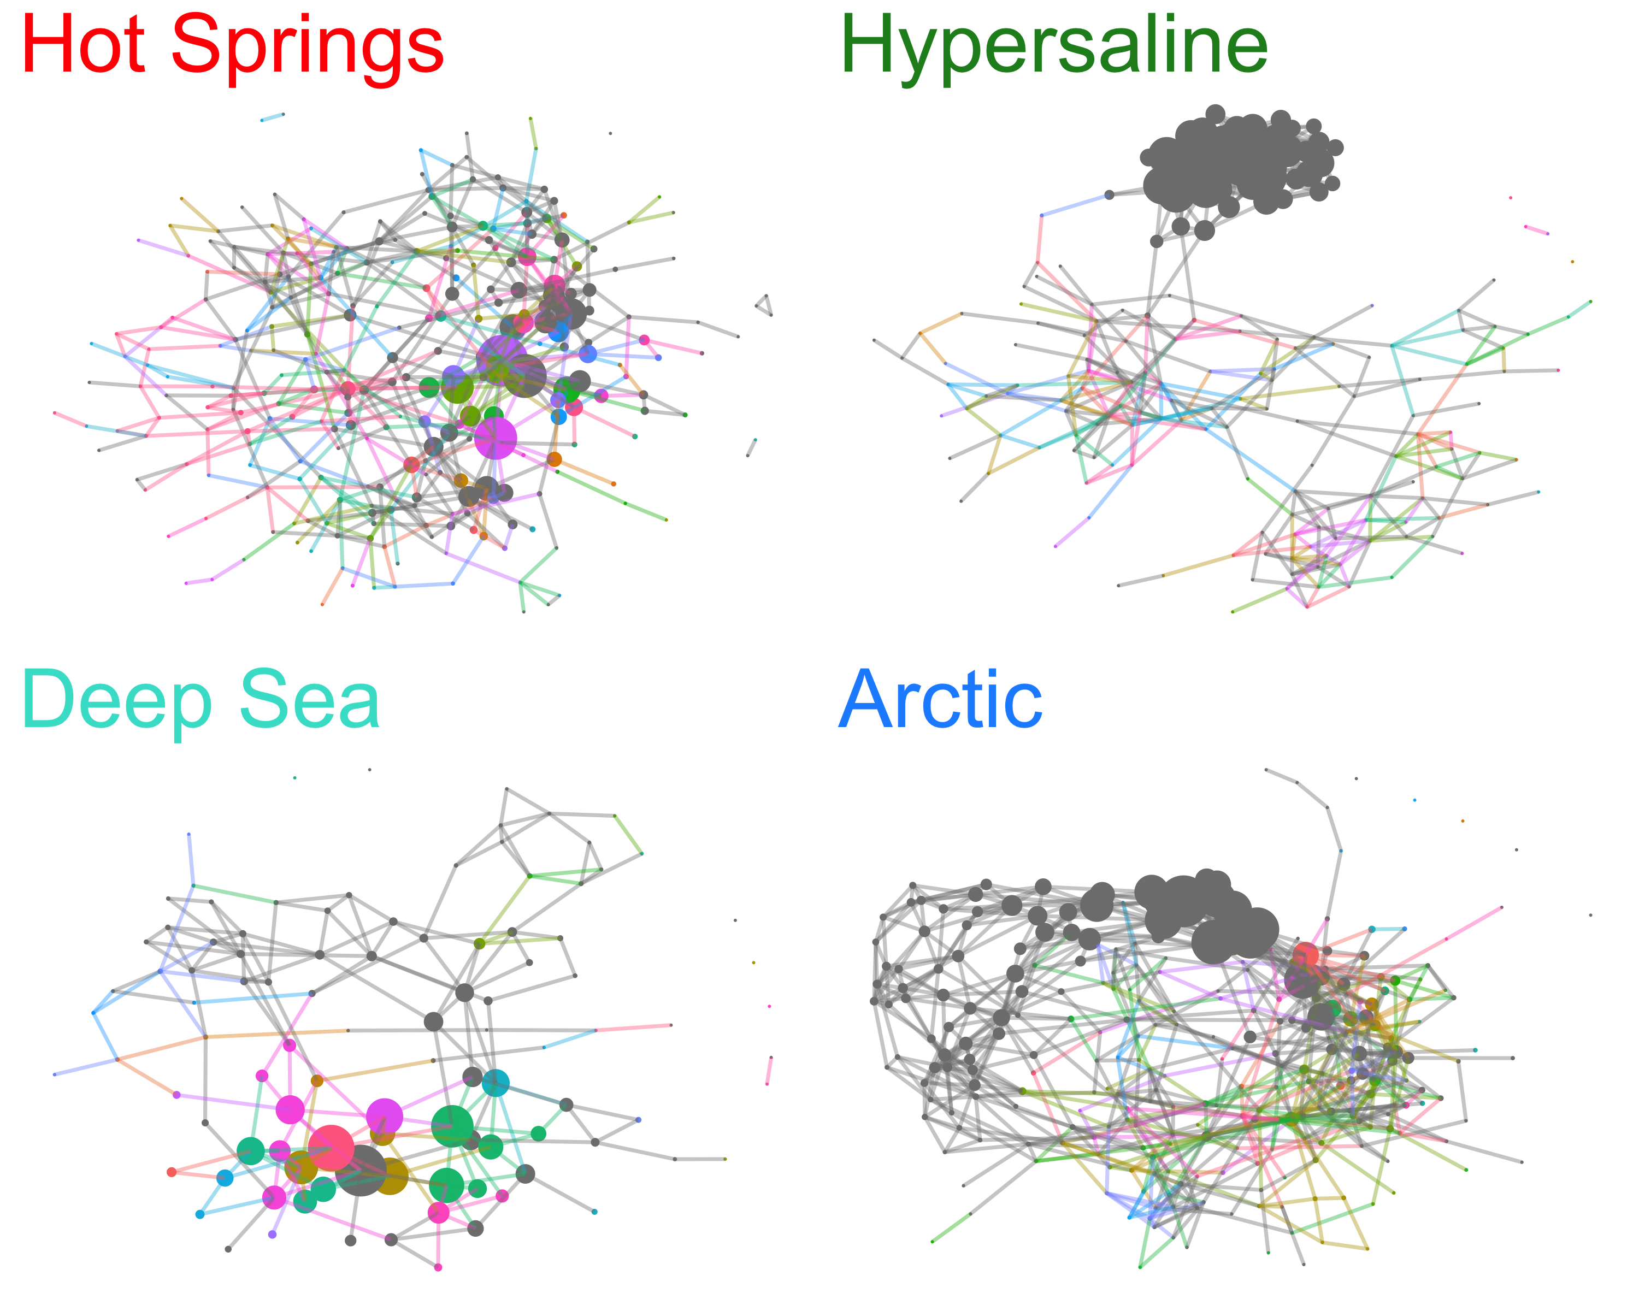
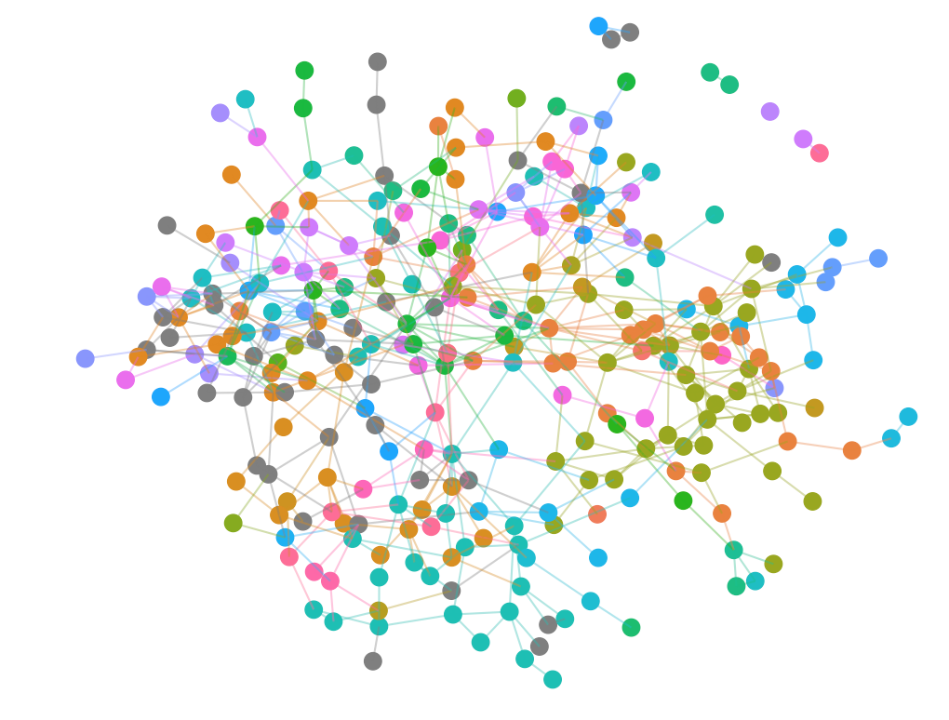
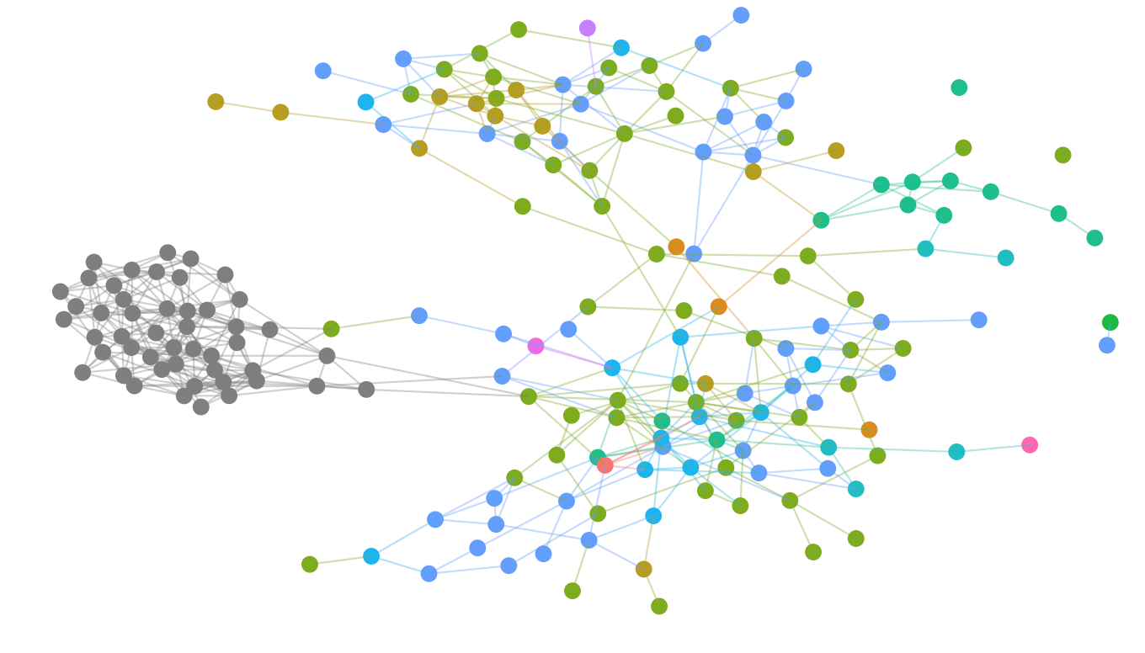
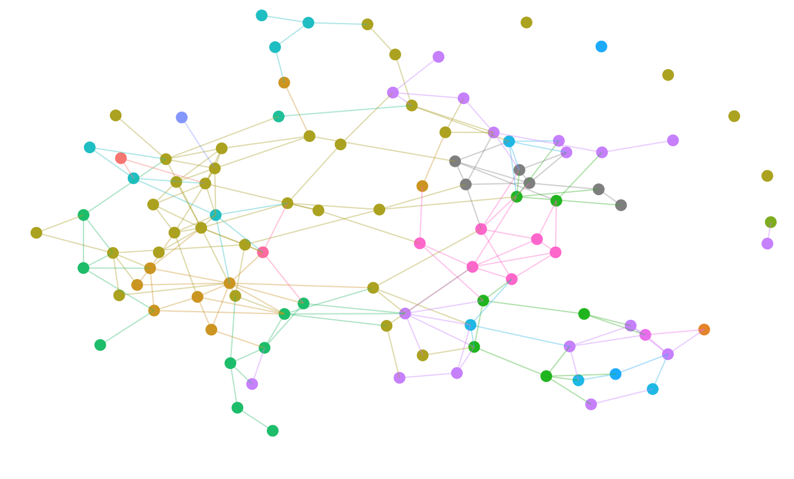
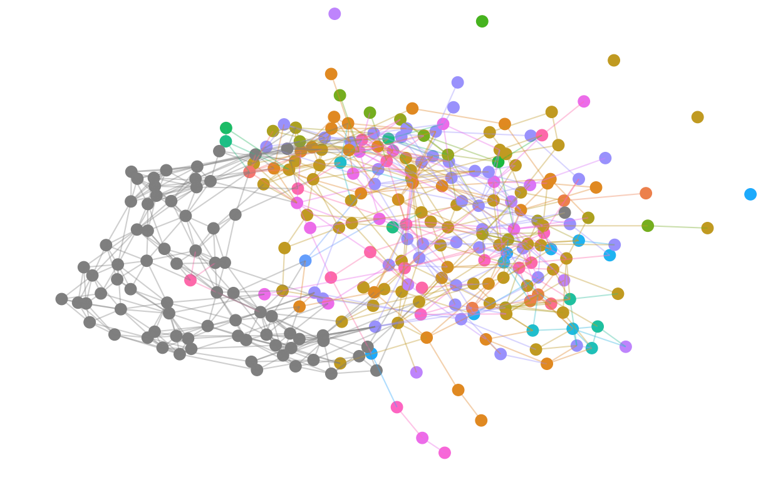
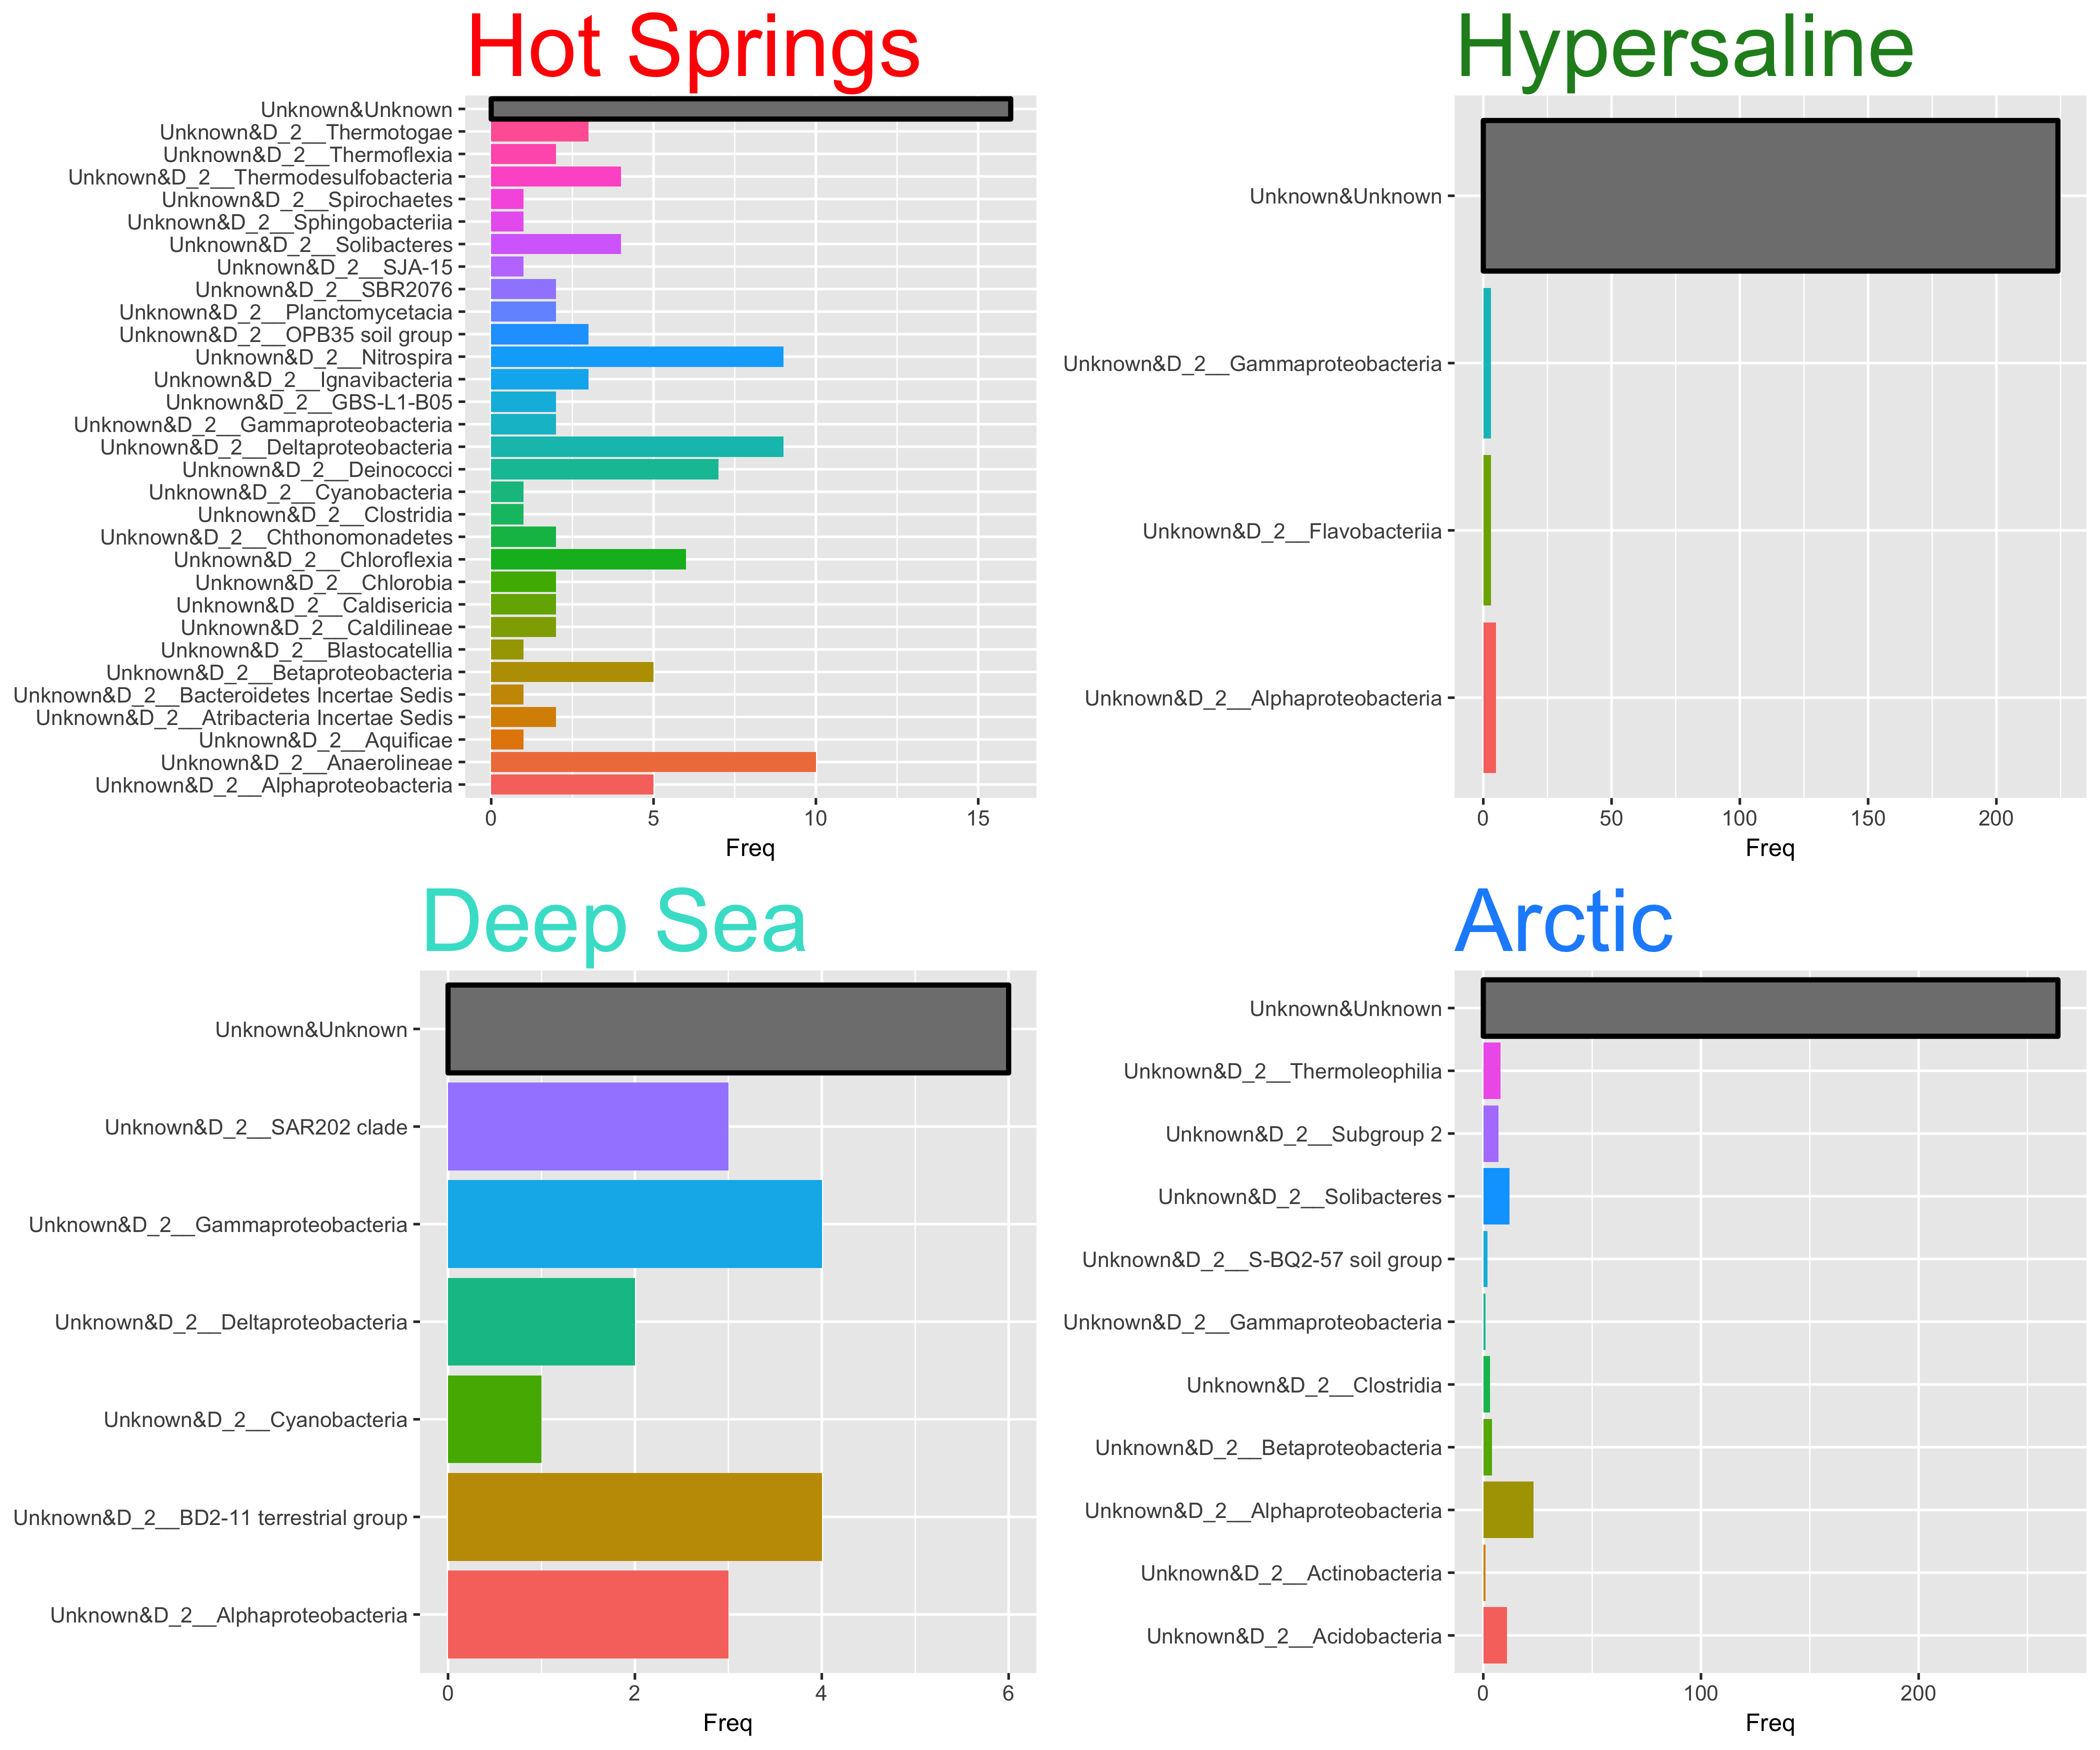
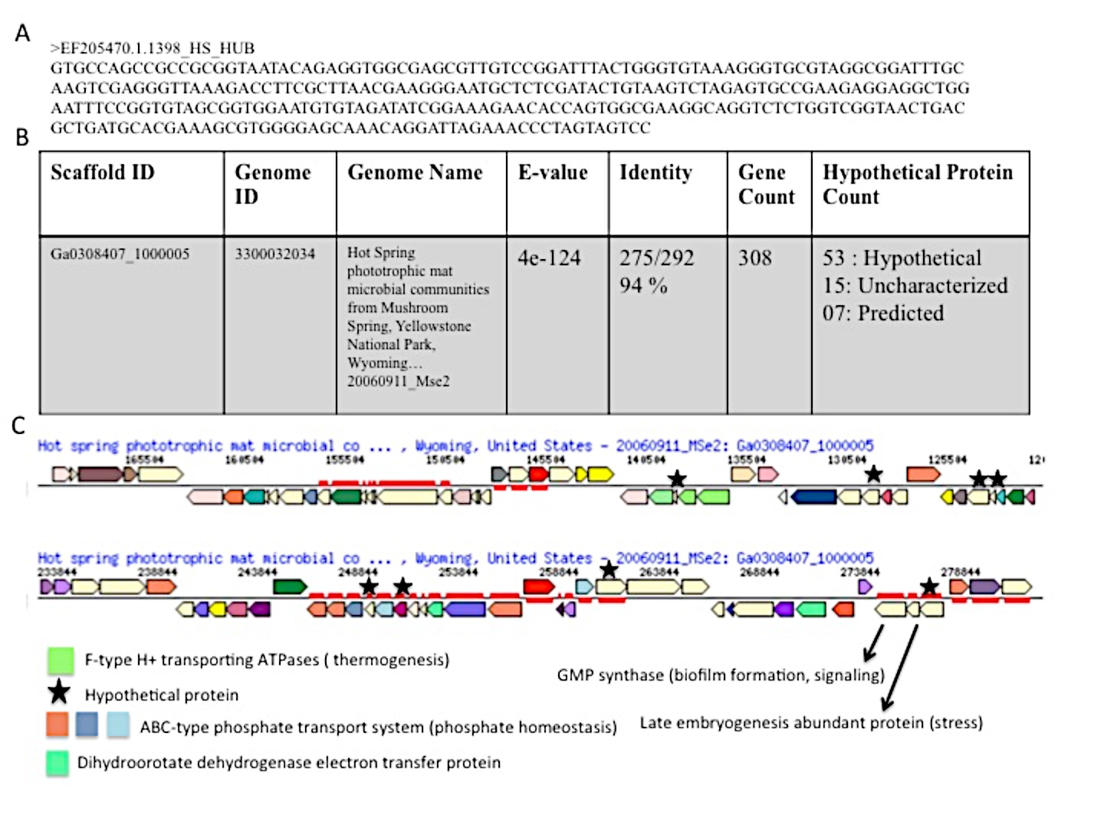
EEB-503
06/23/19
Unraveling the Role of Microbial Dark Matter in
Extreme Environmental Networks
Tatyana Zamkovaya¹ and Ana Conesa²
Department of Microbiology and Cell Science, University of Florida
Genetics Institute, University of Florida
University of Florida
727-348-9482
tatyanaz@ufl.edu
Abstract
Methodology
Results (cont.)
The majority of the microbes that make up Earth’s biodiversity are currently uncharacterized and cannot be grown using traditional cultivation techniques. These unknown microbes can now be unveiled by the use of metagenomics, a method of studying microbial samples directly from the environment. However, the role of these microbes, called Microbial Dark Matter, remains mysterious. Although we now know that Microbial Dark Matter are widely abundant across environments, we still do not know how relevant these unknown microbes are to their communities or the environment overall. Our aim was to understand how Microbial Dark Matter impacts microbial community interactions within and across varying ecosystems. To do so, a combination of a bioinformatics pipeline and network theory was applied to a comprehensive dataset of four extreme aquatic environments (hot springs, hypersaline, deep sea, and arctic) created from publicly available studies. To analyze how microbial interactions and the microbial community itself change in response to Microbial Dark Matter, networks were constructed of each environment with and without unknown organisms at multiple taxonomic classification levels. Different network measures were used to quantify the importance of unknowns within each environment at each classification level. The results of this strategy show that each environment differs in terms of the number of unknown microbes and the taxonomic diversity of neighboring microbes. We found that unknown microbes have a significant local role as hubs for all environments and significantly affect community composition for arctic, deep sea, and hypersaline environments. Unknown microbes act as important bridges between taxa within the arctic and deep sea environments. For arctic and hypersaline communities, unknowns play peripheral roles, interacting exclusively with each other, whereas for the deep sea community, unknowns play a significant central role. Our study reveals the importance of Microbial Dark Matter in shaping environmental interactions and provides a framework for highlighting specific unknowns worthy of characterization.
MDM play important roles in interconnectedness and community structure
Betweenness Centrality Comparison
Closeness Centrality Comparison
MDM significantly shape community structure of extreme environmental networks
Deep Sea and Arctic unknowns, at multiple taxonomic levels
protect interconnectedness of network
maintain relationships of known taxa
Hypersaline and Arctic unknowns are peripheral players
Central Deep Sea unknowns at family level maintain community structure
Aim
MDM act as hubs at genus level for all environments
To establish a method to predict the ecological significance of Microbial Dark Matter (unknowns)
Results
All nodes are resized by hub score
(larger hub score = larger node)
and colored by genus classification (gray = MDM)
Neighbor diversity differs but frequency of co-occurrence with other unknown classes is similar across environments
Data
Hot Springs Class
Hypersaline Class
2A. Extreme environmental microbial networks at class level
Nodes (taxa) are colored by class and edges represent co-occurrence relationships between taxa (SpiecEasi MB, λ=0.05).
Any taxa that were MDM at Class level (unassigned, ambiguous, or unknown) are colored in gray.
Unknowns have top hub scores
across all environments
having high interconnectedness and
high interactions with all other taxa
291 nodes; 552 edges
42 classes
193 nodes; 516 edges
12 classes
Deep Sea Class
Arctic Class
Highest # Class Unknowns:
Arctic & Hypersaline
Conclusions
Hot Springs (260 samples)
Hypersaline (285 samples)
102 nodes; 194 edges
16 classes
279 nodes; 797 edges
Unknown taxa play important roles as hubs for all observed environments
Characterization and functional analysis of MDM should be focused on MDM hubs
Deep Sea (255 samples)
Arctic (286 samples)
27 classes
Figure 1. Map of samples collected.
2B. Taxonomic diversity of unknown class neighbors.
Frequency of co-occurrence relationships (y-axis) of Unknowns with all other classes present in network( x-axis).
Unknown-unknown edges are colored in gray and make up largest proportion.
Future Work and Implications
Table 1. Sample and OTU Comparison between environments
MDM hubs may possess
high # novel & adaptation-related genes and pathways necessary for survival of
harsh environments within and beyond Earth.
Specific 16S sequences of unknown hubs can be used to mine metagenomics databases
Future studies will shed light on unique gene functions of MDM and role of MDM in formation, function and evolution
of extreme ecosystems.
For all environments,
Unknowns
co-occur most with other unknowns
Unknowns co-occur with
highest # classes in Hot Springs
lowest # classes in Hypersaline
Bibliography
Caporaso JG, Kuczynski J, Stombaugh J, et al. QIIME allows analysis of high-throughput community sequencing data. Nat Methods. 2010;7(5):335-6.
Kurtz ZD, Müller CL, Miraldi ER, Littman DR, Blaser MJ, et al. (2015) Sparse and Compositionally Robust Inference of Microbial Ecological Networks. PLOS Computational Biology 11(5): e1004226. https://doi.org/10.1371/journal.pcbi.1004226
R Core Team (2017). R: A language and environment for statistical computing. R Foundation for Statistical Computing, Vienna, Austria.
URL https://www.R-project.org/.
Notes:
Datasets – only show mel and don’t need to explain etoh treatment
SQANTI
transcripts per gene
number of transcripts TSS distance FSM
Number of genes that are in all four libraries with a single isoform (how many are annotated to have 1 and how many are annotated to have multiple)
track of DSCAM (possibly >15 isoforms)

